Slide 1
Agenda
LLM APIs & Integration
AI Pair Programming
Code Analysis & Refactoring

Slide 2
API’s
Application Programming Interface
Set of rules that allows 2 software programs communicate or interact with each other

Slide 3
LLM APIs & Integration
Hugging Face API
OpenAI API
Anthropic API
Error handling
Rate limiting

Slide 4
Hugging Face
Offers thousands of open-source models (Mistral, Falcon, etc.)
Hosted models or run your own via transformers library
Transformers- python lib by hugging face
- use diff models with it
- used for NLP tasks
Models can be downloaded, run locally, or used via API
Use Case: Great for experimenting with different models or deploying open-source LLMs

Slide 5
What is Hugging Face API?
Hugging Face API - we can use any model hosted on Hugging Face without installing it
How It Works:
Send a POST request with your input text
Get back the output (like translation, summarization, generation)
Requires API key for authentication (free tokens available)
You can use it via Postman, Python, or LangChain

Slide 6
Postman
Postman is a tool used to: *****(testing API ‘s and getting response)
1) Send API requests
2) Visualize responses from servers
3) Testing and debug APIs
4) Quickly check prompts, models, and outputs
It helps developers interact with APIs without writing code
Feature | Purpose
GET, POST ,DELETE support | Test any API method
Authorization | Add tokens easily
JSON Body Input | Send text or prompt to models
Output | See model responses clearly

Slide 7
Max_new_tokens - Limits new tokens generated (output)
Max_length - Limits both input & output
Width - Sets no.of characters per line
Parameter | Use with... | Purpose | InferenceClient.chat_completion()?
max_tokens | InferenceClient | Limits generated words/tokens | ✅ Yes
max_new_tokens | transformers.pipeline() | Limits new generated content | ❌ No
max_length | AutoModel.generate() | Total input + output length | ❌ No
width | textwrap.fill() | Only for screen formatting | ❌ No

Slide 8
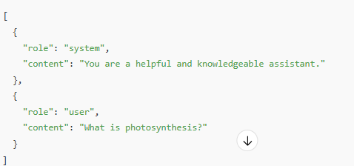
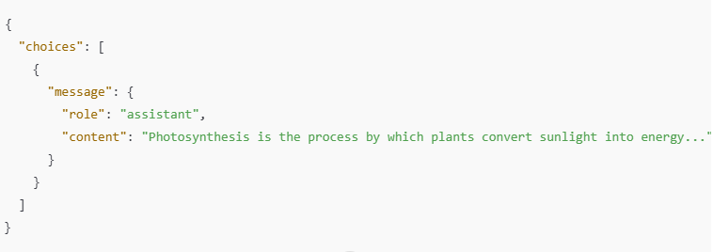

Slide 9
OpenAI API
Provides access to GPT-4, GPT-4o, and GPT-3.5 models.
Supports tasks like:
  Text generation
  Summarization
  Q&A
  Code generation
Requires API Key for authentication.
Supports temperature tuning.
Use Case: Best for general-purpose NLP and reliable generation quality.

Slide 10
Anthropic API
Anthropic API (Claude)
Claude is known for safer and more thoughtful responses.
Uses messages endpoint similar to OpenAI’s chat
Supports Claude 1, 2, 3, 4 (latest) models.
Requires API key and has system prompt support.
Use Case: Ideal for aligned and ethical conversational agents.

Slide 11
Feature | ChatGPT (GPT-4) | Claude (Opus/Sonnet)
Refusal Style | Policy-driven: “I can’t do that.” | Principle-driven: “Here’s why I won’t.”
Tone | Neutral & informative | Neutral, but more ethical and thoughtful
Training method | Human feedback (RLHF) | Constitutional AI (rules + values)
Follow-ups | Offers info if asked | Proactively explains & suggests alternatives

Slide 12
Error Handling
Error Handling in API Integration
Common errors:
  401 Unauthorized – Invalid API key.
  429 Too Many Requests – Rate limit exceeded.
  500/502/504 – Server errors or timeouts.

Slide 13
Rate Limiting
Understanding Rate Limiting
Each API has its own usage quota (e.g., 60 requests/min).
Exceeding limits may:
  Delay responses
  Block access temporarily
Strategies:
Queue requests
Switch to fallback models if primary is overloaded

Slide 14
Fallback Mechanism
Detect failure
  System monitors for timeouts, errors, or failed responses from an API (e.g., GPT-4 times out).
Switch to next model in priority chain
  If one model (e.g., GPT-4) fails, it falls back to the next one in the list.
Maintain consistent context and prompt
  The conversation context or prompt is preserved, so the next model can continue seamlessly.
Benefits:
Improved reliability
Lower latency (when fastest available is chosen)
Balanced load between APIs

Slide 15
Summary
Hugging Face ,OpenAI, Anthropic Hugging Face offer powerful APIs for LLMs.
Robust error handling and rate limiting are essential for production-grade bots.
Multi-model chatbot with API fallback increases uptime and response reliability.

Slide 16
AI Pair Programming
• GitHub Copilot
• Amazon CodeWhisperer
• Cursor AI
• Lovable AI
• Effective prompting for code

Slide 17
What is AI Pair Programming?
Traditional pair programming --- where two developers write code together — one writes, the other reviews
AI pair programming --- writing code with the help of an AI assistant.
Think AI as a super-smart teammate:
Suggests code as you type
Completes functions
Explain & Reduce errors
Finds bugs
Speeds Boosts productivity

Slide 18
AI Pair Programming
GitHub Copilot
AI powered code completion tool- by GitHub & OpenAI.
Autocompletes code in real time.
Supports multiple languages: Python, JavaScript, Java, etc.
Integrates directly with VS Code & Pycharm (python)
Professionals , Developers,
Use Case: When you start typing any code – it completes full function

Slide 19
Lovable AI
A collaborative code-generation platform.
Lightweight code assistant designed for students, early learners, or simple projects
Helps refining code in real time.
Provides gentle suggestions and explanations
Helps with comments, docs, debugging, and even UI/UX
Students , Beginners
Use Case: If you start typing HTML, It suggests accessible tags and explains attributes.

Slide 20
Cursor AI
(Natural Language)
A developer-focused code editor with AI in built
Allows natural language queries directly in code editor.
Built-in refactoring, debugging, and context-aware code edits.
Use Case: Highlight a function → Ask “Optimize this” → refactors it for you.

Slide 21
Amazon CodeWhisperer
AI-powered - code completion tool from AWS.
Offers context-aware suggestions.
Trained on AWS-specific code snippets.
Suggests cloud-specific code (e.g., AWS Lambda, S3, DynamoDB)
Use Case: If you are writing a Python Lambda function, It auto-suggests AWS-compatible code.

Slide 22
Effective Prompting for Code
Good prompts : Better AI output.
Tips:
  Be specific: “Write a Python function that reads a CSV file and filters rows with salary > 50000”
  Use examples : “Use pandas library to read the csv and print top 5 rows
  Mention constraints: "Don't use Numpy library“

Slide 23
Code Analysis & Refactoring
Code Analysis & Refactoring
• Code explanation
• Automated refactoring
• Code review
• Test generation

Slide 24
Code Analysis &Refactoring
Code Explanation
AI tools can explain code in plain language.
Supports documentation debugging.
Helpful for:
  Understanding third-party libraries
  New developers learning from code
Example Prompt: “Explain this Python function line by line.”

Slide 25
Automated Refactoring
AI tools suggest improvements:
  Remove duplicate code
  Rename variables for clarity
  Improve loop conditions and logic
Keeps code clean, readable, and efficient.

Slide 26
Code Review with AI
Reviews Pull Requests automatically.
Detects
  Security issues
  Inefficient logic
  Missing documentation
Benefits:
Faster feedback loop
Reduces human review time
Enforces best practices

Slide 27
Test Case Generation
Generate unit, integration, or API tests from code.
Based on:
  Function input/output
  Edge case scenarios
Useful for TDD and increasing code coverage.
Example Prompt: “Write pytest test cases for this function.”

